Slide 1
Me
# Joel “@ZappedCow” Lauener
# Level 10 software developer
# Do make games but tend to not finish them ;p
(or forget to pay the web host fees)
# Previous work: Zoop, ...:D, Just Type This, HCK_2_0_0, Memory Battle, Wellma, Card&Dragons, CastleBoy and many (even) smaller games
# Working on: BlokQuest (www.blokquest.ch)

Slide 2
The Arduboy
Chapter I

Slide 3
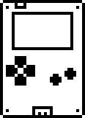
What’s that?
“Arduboy is a miniature game system the size of a credit card. It comes installed with a classic 8-bit game and can be reprogrammed from a library of open source games available online. Arduboy is open source so you can learn to code and create your own games.”
http://www.arduboy.com/

Slide 4
The numbers
# 128x64 1-Bit OLED Matrix Display
# 6 Buttons (4 directions + 2 actions)
# 6 Hour Battery, USB connection
# Piezo Speaker and RGB LED
# Uses an Arduino controller:
- 8-Bit 16Mhz Atmega 32u4
- 32KB Flash
- 2.5KB RAM
- 1KB EEPROM

Slide 5
The Flash: 32 KB
Used to store program and static data (e.g. sprites, maps, music).
# Arduino only give access to 28KB (4KB for system)
# Arduino/Arduboy library uses ~ 9Kb
# Community provided libs: Arduboy2, ARGLib
- Smaller footprint
Sprite support (draw mode, transparency)
Sfx/music support
> The REAL number: 20 KB <

Slide 6
The RAM: 2.5KB
Used to store dynamic data (e.g. position of an entity, variable in the stack).
# Dynamic allocation is a big NO, everything is pre-allocated
# System uses 207 bytes
# Screen buffer eats 1KB
# Safety zone (local variable + boot loader): 700 bytes
> The REAL number: 629 bytes <

Slide 7
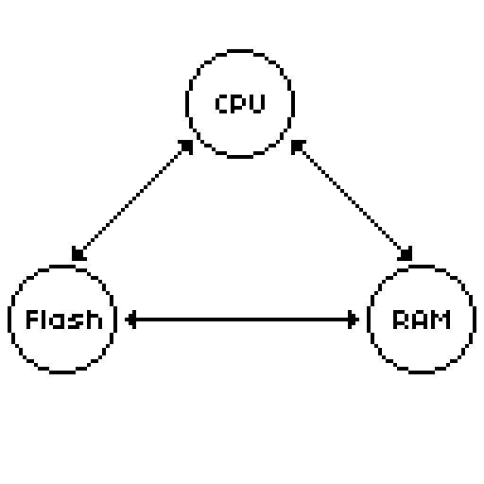
Great Triangle of hell

Slide 8
Why limit yourself?
# Because it’s fun!!
# It encourages creativity (no white paper block)
# Allows to focus on core elements of game design
- good for prototyping/exploration of mechanics
- help fighting against feature creep
# Even a single person can fully use the system
- feeling of completeness
- fair competition
# NOSTALGIA

Slide 9
Other ways to do it
# Homebrew: The hardcore way
# Fantasy consoles: The cosy way
- Pico-8 (https://www.lexaloffle.com/pico-8.php)
- PV8 (https://pixelvision8.itch.io/game-creator)
# Game jams!
- Theme
- Restriction (e.g. #lowrezjam)
- Time limit
- Team size limitation (e.g. Ludum Dare compo)

Slide 10
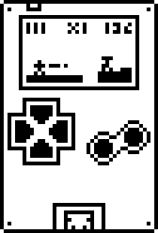
Questions?

Slide 11
Chapter II

Slide 12
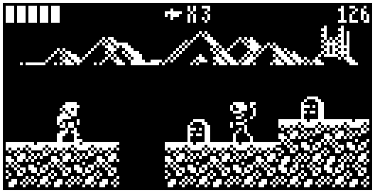
What’s that?
CastleBoy is a platformer for the Arduboy inspired by early versions of Castlevania
https://github.com/jlauener/CastleBoy

Slide 13
Who should I blame?
# Joel “@ZappedCow” Lauener: Design, Code, Sfx
# Ian “@Increment” Ford: Art

Slide 14
Castlevania
Castlevania is an adventure platformer game developed by Konami that is about a vampire hunter fighting Dracula with a whip.
Early versions:
# Castlevania, NES, 1986
# Castlevania: The Adventure, GB, 1989
# Castlevania II: Belmont’s Revenge, GB, 1991
# Super Castlevania IV, SNES, 1991

Slide 15
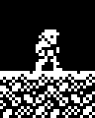
Mechanic: Movement
# Player height is 2 tiles (vs 3 tiles in Castlevania)
# Can jump 2 tile high
walk jump

Slide 16
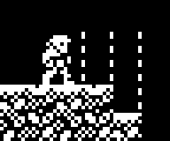
Mechanic: Attack!
# Vertical hit zone is in the middle of second tile
# 2 tiles length
# Can attack while jumping to hit higher objects

Slide 17
Mechanic: Candle
# Spawns a collectible when hit
# Gives reason to player to make small detours
# Can be put in tricky places as it’s optional

Slide 18
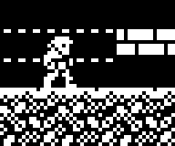
Mechanic: Ducking
# While ducking player is 1 tile high
# Player can walk while ducking, but slower
# Can attack while ducking to hit objects close to ground
# Useful for dodging, taking secret passages and attacking

Slide 19
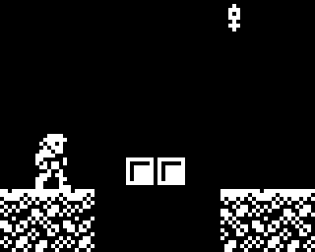
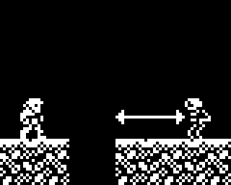
Mechanic: Knife
# Knife can be collected from (tricky) candles
# Player can throw knife to perform a ranged attack
# Hard to balance!
Good candle placement Good knife opportunity

Slide 20
The controls
# Use all buttons of the Arduboy!

Slide 21
Levels and enemies
# Linear progression
# Lot of interactions with enemies, not much platforming
# No enemy/candle respawn (unlike Castlevania)
# Timer for speed running
# 3 unique stage each with his own style
# 6 enemies
# 3 bosses each with different ability
# 4 active elements (e.g. moving platform)

Slide 22
Technical constraints
# The biggest issue is storing the maps in the Flash
# Total game has:
- 746x8=5968 tiles
- 146 entities
# Naive approach: 1 byte per tile, 3 bytes per entity: 6.2KB
# Better approach: 4 bits per tile, 2 bytes per entity: 3.2KB
# Our approach: 2 bits per tile, 2 bytes per entity: 1.7KB
# But how to render nice stages with only 4 tiles?

Slide 23
Stage rendering
# Render column by column
- Easy to detect solid edges (start/stop)
# Use modulo for chessboard effect
0 empty 1 prop 2 solid 3 solid alt

Slide 24
